Slide 1
Advanced Driver Assistance System
Paper by Felipe Jiménez a, José Eugenio Naranjo, José Javier Anaya
Presentation by Somesh Bagadiya

Slide 2
What is Advanced Driver Assistance System (ADAS)?
These are technologies and systems designed to assist drivers in the driving process and make it safer and more efficient
ADAS technologies are seen as a crucial step toward the development of autonomous vehicles, as they lay the foundation for automation by gradually taking over specific driving tasks.
They contribute to improved road safety and can enhance the overall driving experience.
It is the 2nd level of automation for self driving cars.

Slide 3
Why we need ADAS?
Enhanced Safety
Optimized Fuel Efficiency
Smart Route Optimization
Next-Level Convenience
Future-Ready Mobility
Notes:
Adas provides us features like.
Enhanced Safety: Reduce accidents attributed to human error through the implementation of Advanced Driver Assistance Systems (ADAS), promoting a safer driving environment.
Optimized Fuel Efficiency: Utilize ADAS features like adaptive cruise control and predictive cruise control to optimize vehicle fuel consumption, contributing to cost savings and environmental sustainability.
Smart Route Optimization: Implement ADAS-driven navigation systems to intelligently choose routes, minimizing fuel usage and travel time, making every journey more efficient.
Stress Reduction in Traffic: ADAS technologies, including traffic jam assist, alleviate the stress of driving in congested conditions, enhancing the overall driving experience.
Next-Level Convenience: Enjoy the benefits of connected vehicle technologies that provide real-time traffic updates and road condition information, offering a more convenient and informed driving experience.
Future-Ready Mobility: Embrace ADAS as a stepping stone toward the development of autonomous vehicles, laying the groundwork for a future of safer, more efficient, and stress-free transportation.

Slide 4
How to implement ADAS?
There are two parts of implementing ADAS.
1. Onboard perception system.
2. Communication systems between vehicles and infrastructure.
Notes:
Ill be talking about both in detail in later slide, but for now
enables the vehicle to "see" and interpret its surroundings. This technology, often utilizing cameras, radar, and sensors, enhances the accuracy of ADAS features, making them more responsive to the driving environment.
Embrace the power of communication systems between vehicles and infrastructure, enables real-time data exchange, facilitating improved traffic management, enhanced safety, and more efficient navigation. By fostering communication between vehicles and infrastructure elements such as traffic signals and road networks, ADAS becomes more responsive and adaptive, paving the way for a connected and intelligent transportation ecosystem.

Slide 5
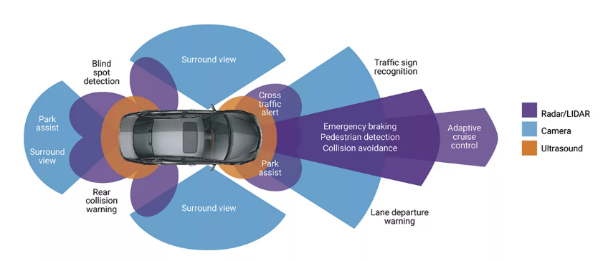
Onboard perception system
It enables the vehicle to "see" and interpret its surroundings. This technology utilizes cameras, radar, and sensors to perceive the environment.

Slide 6
Onboard perception system is responsible for
Object Detection and Recognition
Lane Tracking
Collision Avoidance
Traffic Sign Recognition
Adaptive Cruise Control
Pedestrian Detection
Cross Traffic Alert
Environmental Monitoring
Driver monitoring
Notes:
Object Detection and Recognition: The system identifies and categorizes objects in the vehicle's environment, such as other vehicles, pedestrians, cyclists, road signs, and obstacles.
Lane Tracking: It monitors the vehicle's position within its lane and tracks lane boundaries. This information is crucial for features like Lane Departure Warning and Lane-Keeping Assist.
Collision Avoidance: The system assesses the risk of collisions by continuously monitoring the distance and relative speed between the vehicle and other objects. In the event of an impending collision, the system may trigger safety mechanisms, such as Automatic Emergency Braking.
Traffic Sign Recognition: It recognizes and interprets traffic signs, including speed limits, stop signs, and other regulatory signs. This information can be used to provide real-time alerts to the driver.
Adaptive Cruise Control (ACC): For vehicles equipped with ACC, the perception system helps maintain a safe following distance by detecting the speed and position of vehicles ahead.
Pedestrian Detection: The system is capable of identifying pedestrians near the vehicle, providing critical information for pedestrian safety features and collision avoidance systems.
Cross Traffic Alert: It detects oncoming traffic from the side, especially when the vehicle is backing out of parking spaces, helping to prevent collisions in situations with limited visibility.
Environmental Monitoring: The system assesses environmental conditions, such as weather and lighting, to adapt the vehicle's behavior and optimize the performance of safety features.
Data Fusion: By integrating data from various sensors, such as cameras, radar, and lidar, the perception system creates a comprehensive and accurate representation of the vehicle's surroundings. This data fusion enhances the reliability and effectiveness of the ADAS features.
Driver Monitoring: Some perception systems include features for monitoring the driver's behavior, such as detecting signs of drowsiness or distraction, to enhance overall safety.

Slide 7
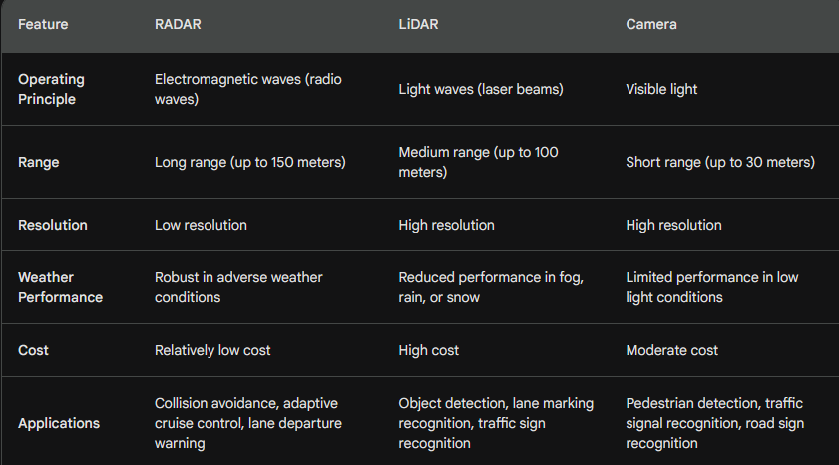
Radar vs Lidar vs Camera
Notes:
The onboard perceptions system is responsible for various applications, Ill be discussing few in depth

Slide 8
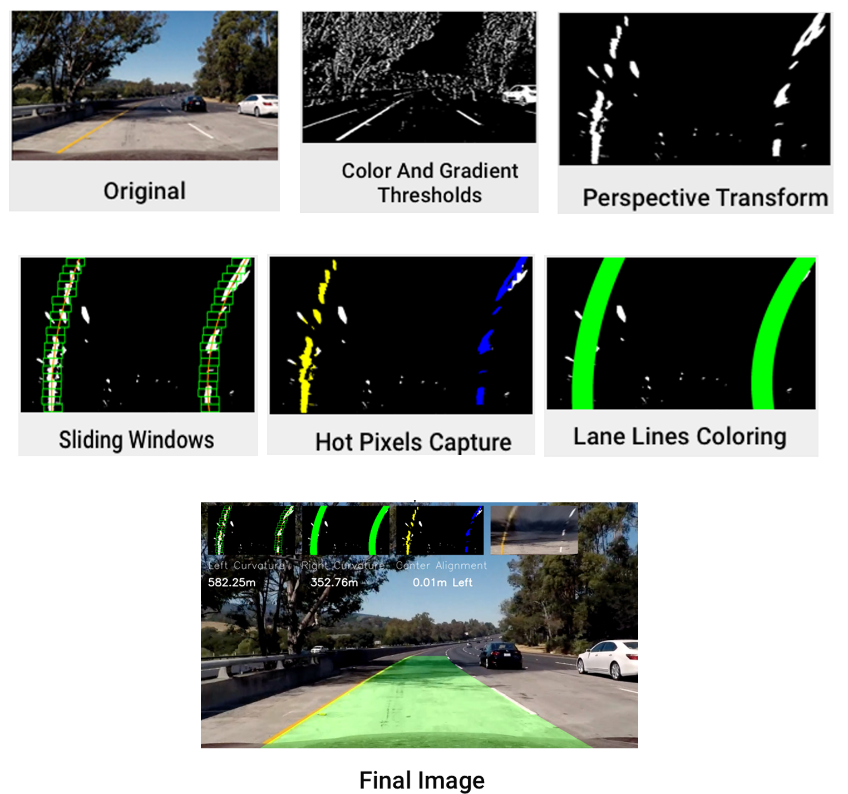
Lane Tracking
Notes:
Lane Tracking.
Take input from the Camera
Turn the image to a gray scale image
Determine the region of interest generally assume it to be upto 10-15 meters ahead of the car
Adjust the white intensity to identify the lanes
There are various ways to detect the lanes.
First thing to do is perspective wrap the image then set the white intensity.
Once the lane is identified, we can determine the lane's center and ensure that the vehicle remains positioned at the center of the lane.
We can use this to alert user to keep the car centered in the lane or even automate the car to maintain the center of the lane.

Slide 9
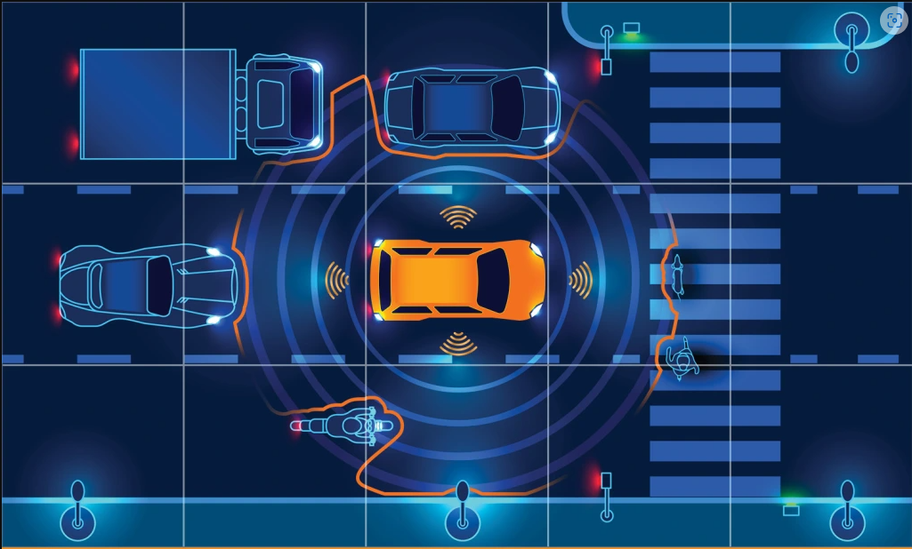
Collision Avoidance
Notes:
We need continuous 360 deg survelience around the car for collision avoidance.
Data Acquisition and Processing:
Collect data from the sensors in real-time, including information about the distance to objects, their speed, and their relative positions.
Process the sensor data
Object Detection and Recognition:
Implement algorithms that can detect and recognize various objects, including vehicles, pedestrians, cyclists, and obstacles.
Classify objects based on their characteristics to assess collision risk and severity.
Risk Assessment and Decision-Making:
Develop algorithms that assess the level of collision risk based on the data collected.
Determine appropriate actions, such as providing warnings to the driver or triggering autonomous intervention.

Slide 10
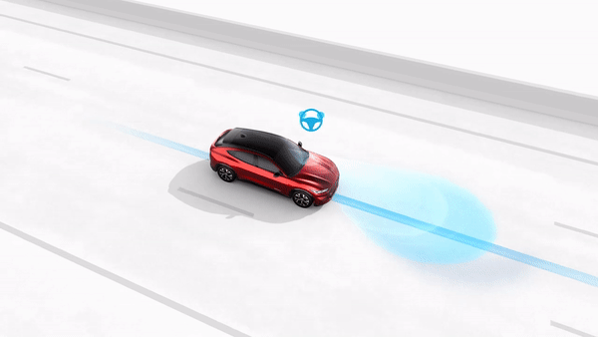
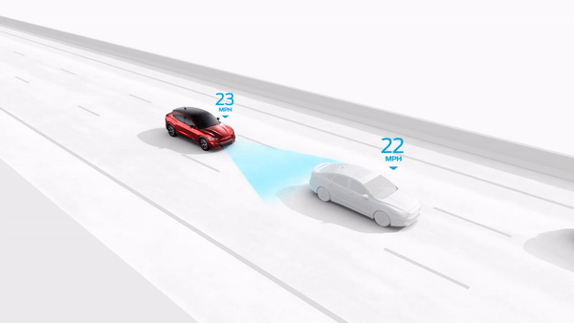
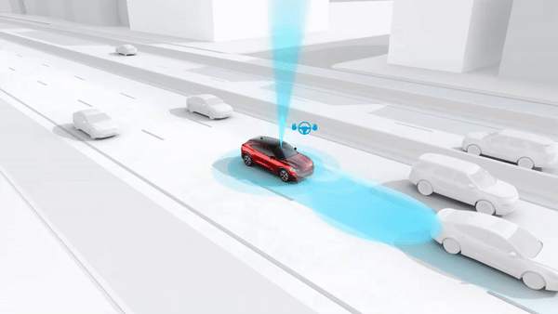
Adaptive Cruise Control
Notes:
Adaptive Cruise control is similar to the normal cruise control but smart.
It can make sure that the car is some seconds behind the car ahead.
Sensor Deployment:
Install radar or lidar sensors on the vehicle to continuously monitor the distance to the vehicle in front.
Position the sensors in a way that provides accurate and reliable information about the surrounding traffic.
Data Acquisition and Processing:
Collect data from the sensors in real-time, including information about the speed and distance of the vehicle ahead.
Process the sensor data using algorithms to accurately determine the relative speed and adjust the following distance.
ACC System Logic:
Develop control algorithms that govern the behavior of the ACC system.
Define parameters for safe following distances and acceleration/deceleration limits.
User Interface:
Integrate ACC controls into the vehicle's user interface, allowing the driver to enable, disable, or adjust ACC settings.
Provide visual or auditory feedback to inform the driver when ACC is active or when the system is making adjustments.
Speed Control Mechanism:
Implement a speed control mechanism that allows the ACC system to adjust the vehicle's speed smoothly and responsively.
Ensure that the ACC system can accelerate or decelerate within the specified limits.
Adaptive control can also check map data to decide the speed of the car.

Slide 11
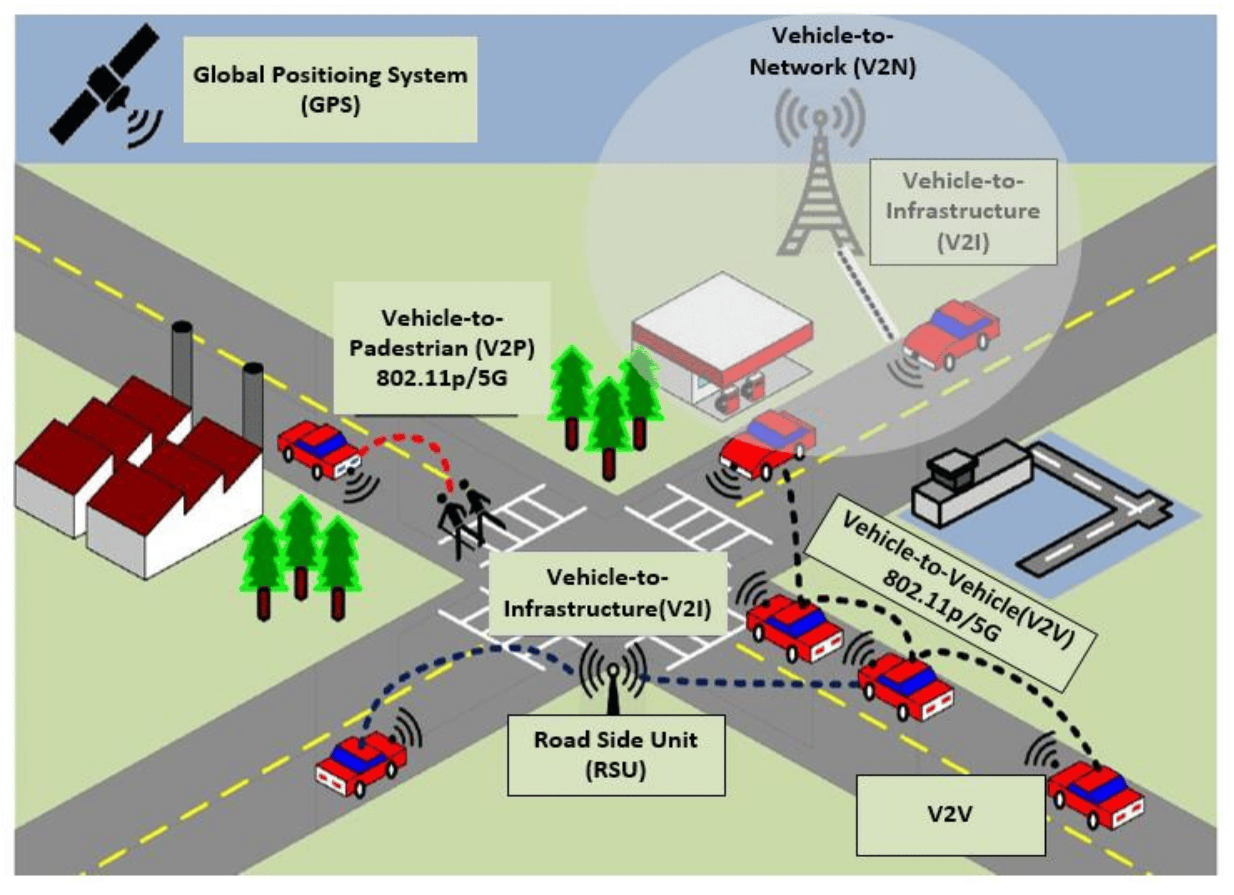
Communication systems between vehicles and infrastructure.
Notes:
There are mainly 3 communications by the vehicle.
V2V
V2P
V2I

Slide 12
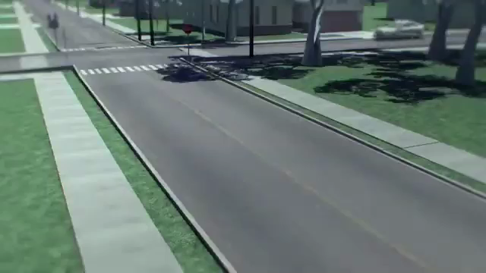
Advantages of communication system between vehicles
Notes:
Explain the examples
V2V can help you avoid crashes on the crossroads
V2V can help guide cars when its safe to overtake
V2V can let other cars know that the traffic ahead has came to a sudden stop to avoid massive collisions
V2V can let other cars know about the wheather and road condition ahead
V2I can let the whole network know about the conditions so that appropriate actions can be taken to avoid accidents.

Slide 13
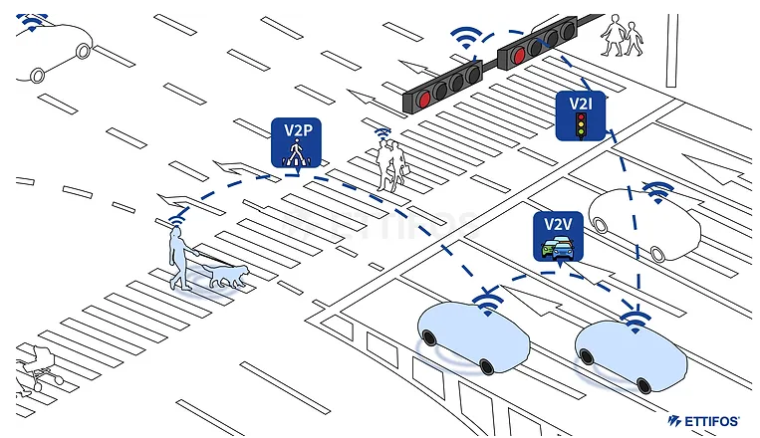
Vehicular Ad-Hoc Network (VANET)
What is Ad-hoc network?
What is VANET?
Notes:
Basically a temporary connection between n devices to communicate between nodes
2. Ad-Hoc Network between vechicles is termed as VANET. It has capability to transmit the data rapidly between nodes and change the network dynamically.
What are node?....nodes are the vehicles in the network for ex car bus bike pedestrian etc.
This is used to transmit safety related imformation between different nodes.
There are two types of VANET’s in use

Slide 14
Ways to implement VANET
DSRC: Dedicated Short-Range Communication
C-V2X: Cellular Vehicle-to-Everything
Notes:
DSRC is an IEEE (Institute of Electrical and Electronics Engineers) 802.11p-based WAVE technology that has been developed from standard Wi-Fi, specifically for use within the automotive and transportation sector.
DSRC uses WLAN technology to establish and create short range communication that allows vehicles to send and receive information.
DSRC was the first vehicle to everything communication standard
Developed by United States Federal Communications Commission (FCC) and has been developing for the past two decades.
the 5.9GHz spectrum band has been dedicated to intelligent transport systems to enable vehicular safety applications and ensure that DSRC communication is not affected by other devices or communications.
DSRC relies on the use of on-board units in vehicles and roadside units on infrastructure to send and receive rapid short range basic safety messages using SAE J2735 message sets without the need for a third party cellular network.
C-V2X:
C-V2X, standardized in 2017, is defined by 3GPP standards.
Like the DSRC standard, C-V2X uses the 5.9GHz band to transmit the necessary information to deliver basic safety messages between the entities on the road.
In addition to using the 5.9GHz band, C-V2X also makes use of existing cellular networks, forming vehicle-to-network (V2N) communication alongside V2V, V2I and V2P.

Slide 15
Similarities and Differences between DSRC and C-V2X
Similarities:
Both DSRC and C-V2X share the same fundamental goal to enhance road safety and make journeys more efficient for road users
Both technologies facilitate low-latency communication exchanges between vehicles, roadside infrastructure and pedestrians using direct communication
Both technologies use the 5.9GHz frequency band to send wireless short range communication
Differences:
C-V2X makes use of cellular networks in its system, in addition to the 5.9GHz frequency band used by the DSRC standard
The DSRC standard only provides short range communication up to 1 km depending on the specific use case, whereas the C-V2X standard provides additional long range communication via networks that extends the range of transmission up to a few kilometers
DSRC and subsequent scenario usage have been well tested over the past two decades by government agencies and private organizations, whereas C-V2X is still in the early stages of development and testing

Slide 16
SAE J2735 and IEEE 802.11p
SAE J2735: This SAE standard specifies a message set, and its data frames and data elements, for use by applications that use vehicle-to-everything (V2X) communications systems. While the data dictionary was originally designed for use over DSRC, this document is intended to be independent of the underlying communications protocols used to exchange data between participants in V2X applications.
IEEE 802.11p is an approved amendment to the IEEE 802.11 standard to add wireless access in vehicular environments (WAVE), a vehicular communication system. It defines enhancements to 802.11 (the basis of products marketed as Wi-Fi) required to support intelligent transportation systems (ITS) applications. This includes data exchange between high-speed vehicles and between the vehicles and the roadside infrastructure, so called vehicle-to-everything (V2X) communication

Slide 17
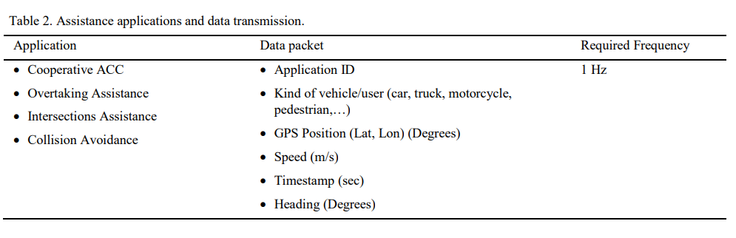
What info is stored in SAE J2735 message packet

Slide 18
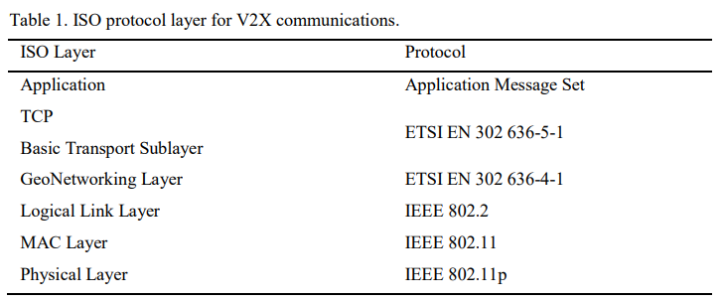
ISO Protocol Layer for V2X
Notes:
Physical Layer is the extension of WiFi wireless data transmission, adapted to transport
Both the link and MAC layers use standard protocols inherited from the classical wired communications.
Geo Networking layer will combine the geological position of the object with the message. GPS coordinates
This implies two facts: first, all DSRC units must equip a GPS receiver;
all packets will be sent to all users in range, but its use will be restricted to a geographic location specified in the data packet itself. This behavior is called geobroadcast.

Slide 19
Onboard perception system and Communication systems between vehicles and infrastructure
Onboard perception systems:
Function: Utilize sensors like cameras, radars, and LiDARs to gather real-time data about the immediate surroundings.
Strengths: Provide detailed and accurate information about nearby objects and road conditions, enabling immediate threat detection and response.
Limitations: Limited range, dependent on line-of-sight, and can be affected by harsh weather or obstructed view.
Communication systems between vehicles and infrastructure:
Function: Facilitate information exchange between vehicles, roadside units, and traffic infrastructure.
Strengths: Expand awareness beyond line-of-sight, receiving information about upcoming traffic situations, hazards, and road closures.
Limitations: Reliant on infrastructure and other vehicles being equipped with compatible communication systems, possible latency in data transmission.

Slide 20
Who is the largest contributors to ADAS Market worldwide?
Mobileye
NVIDIA - DRIVE
Qualcomm - Ride
Valeo
Waymo
Robert Bosch

Slide 21
Thank You

Slide 22
Testing for the perception system
Perception system was tested over 4 different scenarios, in order to provide vehicle detection techniques in real time.
Test 1: Test 1 is performed with raw learning process, no bootstrapping techniques were applied and the images presented different sizes and dimensions.
Test 2: In this case, bootstrapping techniques were presented which helped to identify the features in the SVM. Images still presented different sizes and dimensions.
Test 3: Similar to test 1, no bootstrapping technique was used, however, in this test; the images were resized to a common size.
Test 4: On this test, images were resized as test 3, and bootstrapping technique helped to increase the success rate.

Slide 23
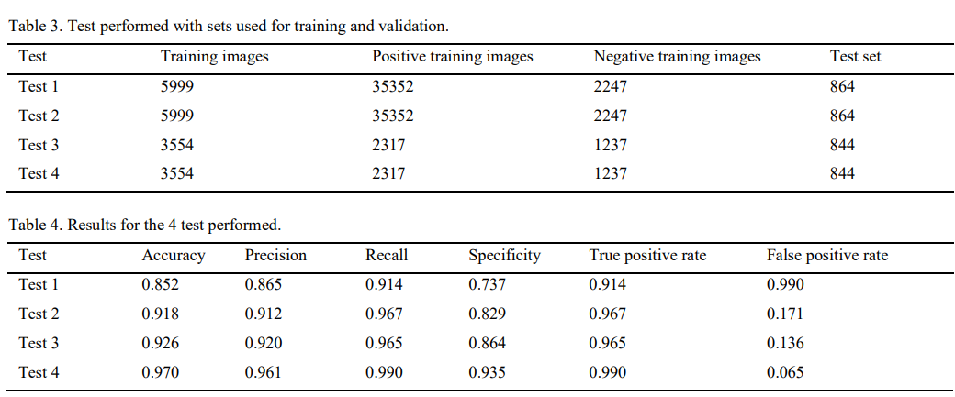
Results

